Slide 1



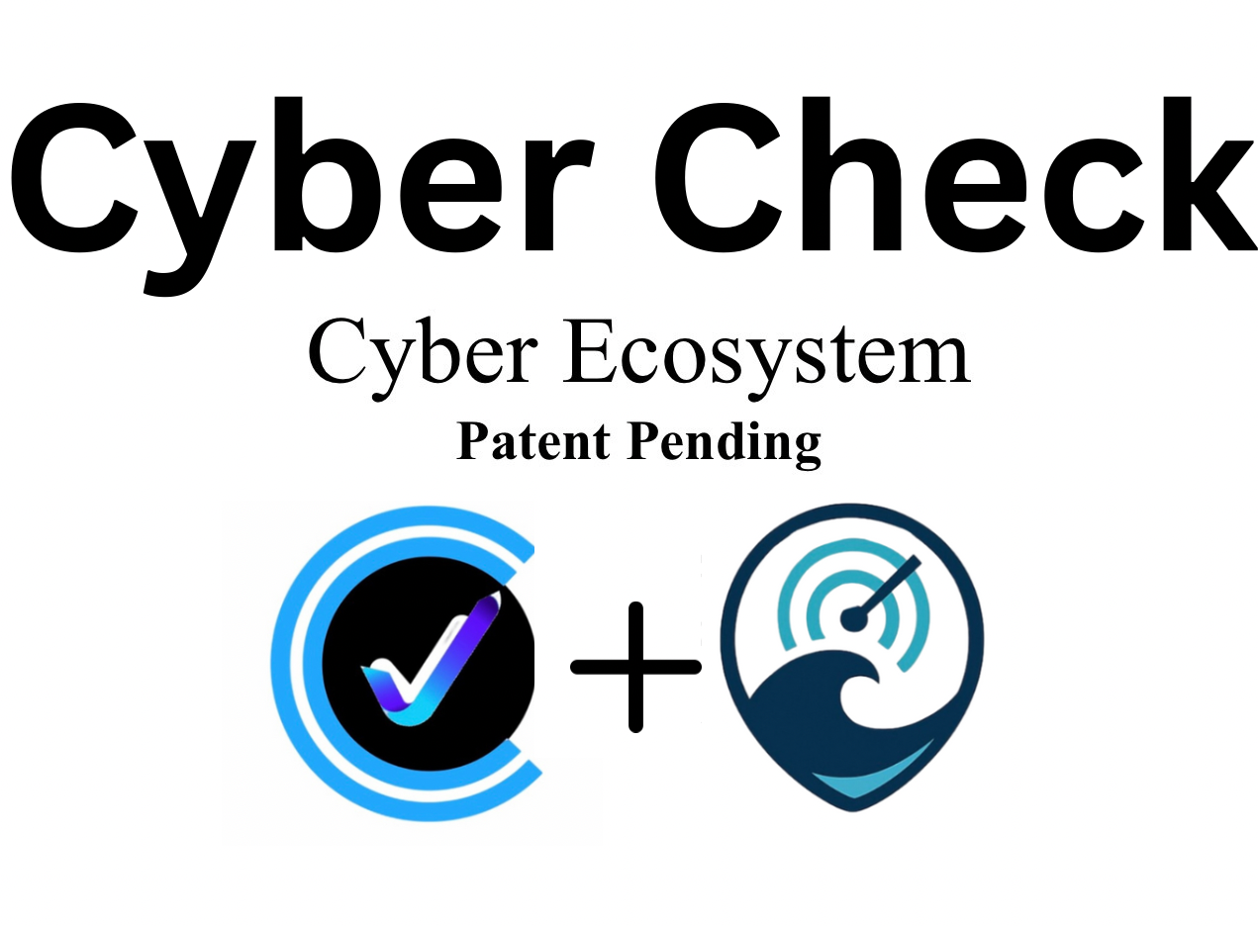


CyberCheck Ecosystem
Patent Pending

Slide 2
The Opportunity
• Restaurants: FOH engagement, loyalty, verified reviews.
• Consumers: Trusted discovery, personalized offers.
• Businesses: Real-time data streams powering growth.
• Unified ecosystem ensures revenue growth, authentic trust, and defensible moat.

Slide 3
CyberCheck — Unified FOH Platform
• Problem: Fragmented guest experience (boring menus, no upsells, weak loyalty).
• Solution: Photo-driven menus, smart upsells, phone-number loyalty, SMS marketing.
• Mini Flow: 🍽️ Menu → 📈 Upsell → 💳 Checkout → 🎁 Loyalty.

Slide 4
CyberMate — Authentic Reviews
• Problem: Fake reviews dominate Yelp, Google, Amazon.
• Solution: Transaction-verified reviews tied to POS/e-commerce orders.
• Mini Flow: 🛒 POS Order → 📲 SMS Invite → ⭐ Verified Review → 🔒 Badge.

Slide 5
Gulf Coast Radar — Tourist Hub
• Problem: Tourists can’t find real-time menus, specials, or events.
• Solution: Central hub for food, drinks, music, and activities.
• Mini Flow: 🔍 Search → 📊 Results → 📱 SMS/Favorites.

Slide 6
Ecosystem Flow
• 🍽️ CyberCheck → ⭐ CyberMate → 🌴 Gulf Coast Radar → 📲 Re-engagement
• Closed-loop data ecosystem driving discovery, trust, and revenue.

Slide 7
Ecosystem Flywheel
• 🎯 Attract → 💵 Convert → ⭐ Verify → 📢 Promote → 🔁 Repeat
• Flywheel ensures continuous growth and engagement.

Slide 8
Key Stats
• 🌴 6M+ tourists visit the Gulf Coast annually, spending $150/day on food & entertainment.
• 📈 CyberCheck boosts restaurant check size by 20–30%.
• ⭐ 40% of online reviews are fake — CyberMate reduces this to 0%.

Slide 9
Closing
Patent Pending
“I’m not here to transform a single industry — I’m here to disrupt how the entire world uses technology in daily life. Not just to make a difference, but to put a dent in the universe.”

